Slide 1




Multi-physics Design Optimization of a GaN Based Integrated Modular Motor Drive System
The 9th International Conference on Power Electronics, Machines and Drives
Mesut Uğur
mesut.ugur@metu.edu.tr
Middle East Technical University
Ankara, Turkey
04/18/2018

Slide 2

Outline
Motivation
System model
Evaluation of design parameters
Optimum system design
Conclusions
References

Slide 3
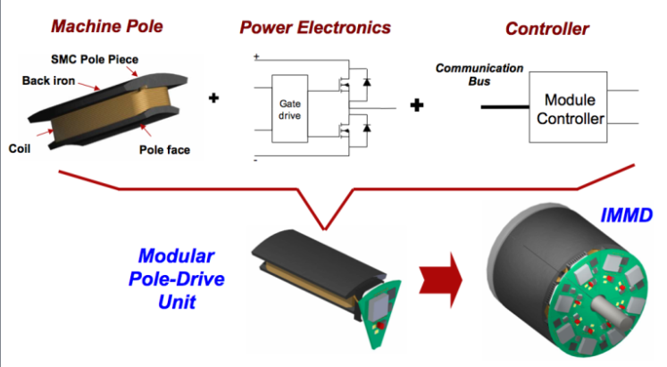
Motivation
Integrated Modular Motor Drive
Increased power density
Reduced cost
Reduced EMI
Fault tolerance
Redundancy
Reduced stress
Shea, A., & Jahns, T. M. (2014). Hardware integration for an integrated modular motor drive including distributed control. In 2014 IEEE Energy Conversion Congress and Exposition (ECCE) (pp. 4881–4887). IEEE.

Slide 4
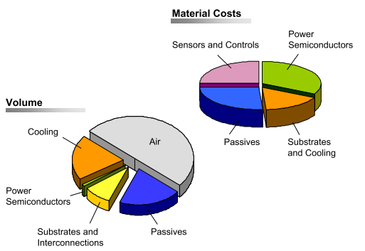
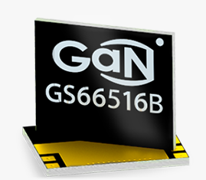
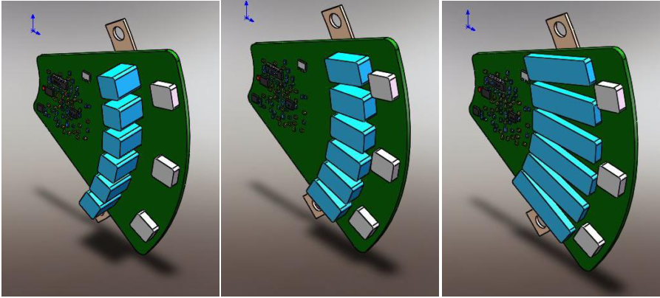
Motivation
Design Challenges
Physical limitations: Thermal management, motor vibration
Structural limitations: Limited available space, converter height
Inter-dependencies between parts
Multi-physics design optimization
GaN Systems. (n.d.). GaN Systems E-mode GaN FETs. Retrieved January 15, 2018, from http://www.gansystems.com/
Marz, M., Schletz, A., Eckardt, B., Egelkraut, S., & Rauh, H. (2010). Power electronics system integration for electric and hybrid vehicles. Integrated Power Electronics Systems (CIPS), 2010 6th International Conference on, 16–18.
Wang, J. (2015). Design of Multilevel Integrated Modular Motor Drive with Gallium Nitride Power Devices. Thesis.

Slide 5
System Model
n
Aspect
ratio
n_{s}
l_{m}
Slot/module/phase
n_{p}
Switching frequency
Modulation depth

Slide 6
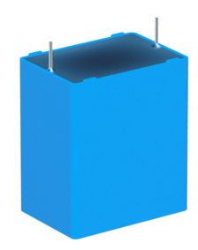
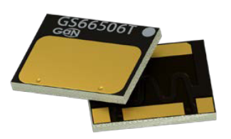
System Model
P_{out}= 8 kW
System Inputs
Constraints
Material properties
Ambient conditions
Datasheet values
T_{amb} = 50 ⁰C
Electric loading
Magnetic loading
Voltage ripple
Electrical
Drive losses
Rated voltage
Device temp.
Current
Thermal
Capacitor size
Electromagnetic
Thermal res.
Torque
Heat sink size
Motor dimensions
Geometrical
Power density
Efficiency
Material cost
Cost function

Slide 7

System Model
Motor dimensioning
DC Link
Interleaving
Shear stress
$$σ=B_{ }A_{rms}$$
Magnetic equivalent circuit
Thermal equivalent circuit
Power density

Slide 8
Design Parameter Evaluation
Switching frequency & Number of modules

Slide 9
Design Parameter Evaluation
Modulation index & Number of modules

Slide 10
Design Parameter Evaluation
Series and Parallel connection

Slide 11
Design Parameter Evaluation
Number of slots/module/phase & Aspect ratio

Slide 12
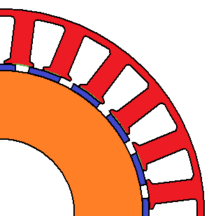
Optimum System Design
Qs = 24
p = 20
α = 0.5
w_{s} = 2
f_{sw} = 50 kHz
m_{a} = 0.9
GaN voltage ratings
Overmodulation
Tooth width
Manufacturing constraints
Drive component cost
Fault tolerance
Drive efficiency: 98.3 %
Motor efficiency: 96.6 %
Power density: 0.71 kW/lt

Slide 13
Conclusions
Integration and modularization of motor drives
Design challenges: Wide Band-Gap Devices
Inter-dependencies between parts
Complete model of an IMMD & Design optimization
New possibilities: interleaving
Discrete nature of components
Switching frequency trade-off
Cost limitations and manufacturability
Fault tolerance

Slide 14
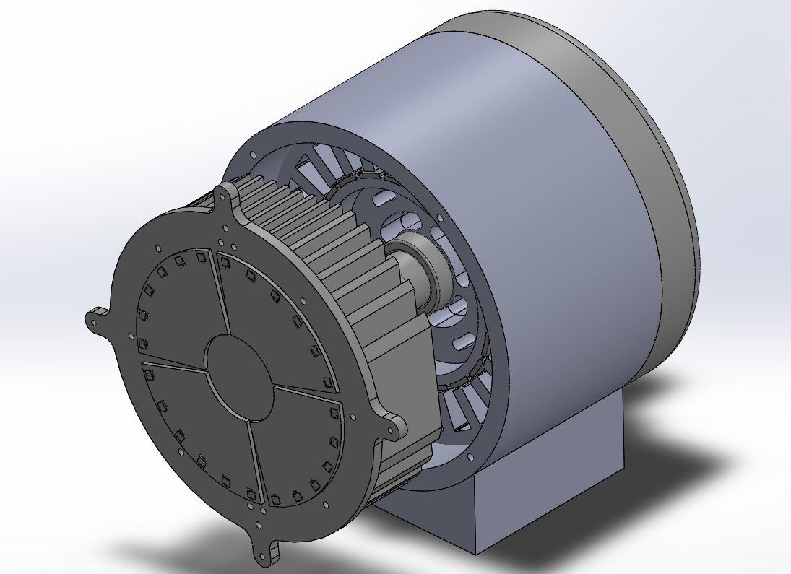
Future Work
Inclusion of torque ripple, cogging torque, vibration effects
Inclusion of motor thermal model and EMI effects
A prototype is under construction with the optimum design parameters

Slide 15
References
[1] G. Lo Calzo, G. Vakil, B. Mecrow, S. Lambert, T. Cox, C. Gerada, M. Johnson, and R. Abebe, “Integrated motor drives: state of the art and future trends,” IET Electr. Power Appl., vol. 10, no. 8, pp. 757–771, Sep. 2016.
[2] M. D. Hennen, M. Niessen, C. Heyers, H. J. Brauer, and R. W. De Doncker, “Development and control of an integrated and distributed inverter for a fault tolerant five-phase switched reluctance traction drive,” IEEE Trans. Power Electron., vol. 27, no. 2, pp. 547–554, 2012.
[3] J. Wang, Y. Li, and Y. Han, “Integrated Modular Motor Drive Design With GaN Power FETs,” IEEE Trans. Ind. Appl., vol. 51, no. c, pp. 3198–3207, 2015.
[4] M. Ugur and O. Keysan, “DC link capacitor optimization for integrated modular motor drives,” 2017 IEEE 26th Int. Symp. Ind. Electron., vol. i, pp. 263–270, 2017.
[5] A. Shea and T. M. Jahns, “Hardware integration for an integrated modular motor drive including distributed control,” in 2014 IEEE Energy Conversion Congress and Exposition (ECCE), 2014, pp. 4881–4887.
[6] N. Bekka, M. E. H. Zaim, N. Bernard, and D. Trichet, “A Novel Methodology for Optimal Design of Fractional Slot with Concentrated Windings,” IEEE Trans. Energy Convers., vol. 31, no. 3, pp. 1153–1160, 2016.
[7] GaN Systems, “GaN Systems.” [Online]. Available: http://www.gansystems.com/. [Accessed: 15-Jan-2018].
[8] TDK, “Film Capacitors, Metallized Polypropylene Film Capacitors (MKP) - B32674...B32674 Datasheet,” no. May. 2015.
[9] R. E. Simons, “Estimating Parallel Plate-Fin Heat Sink Thermal Resistance.” [Online]. Available: https://www.electronics-cooling.com/2003/02/estimating-parallel-plate-fin-heat-sink-thermal-resistance/.

Slide 16

Thank you !
Mesut Uğur
mesut.ugur@metu.edu.tr
Department of Electrical and Electronics Engineering
Middle East Technical University
power.eee.metu.edu.tr

